Slide 1

Statistical Analysis of Hotel booking demand
By:
Carlos Daniel Leobardo Marcelo

Slide 2

Motivation & Summary
Perform an Exploratory Data Analysis (EDA) of two different hotels. (city and beach)
Cancelations are the main revenue leakage in the propriety management Find correlations between Cancelation and various factors.
Create Action Plans to reduce cancelations

Slide 3

Questions & Data
Where do the guests come from?
Which month have the highest number of cancelations?
How many bookings were canceled
Bookings by market segment
Which are the busiest month?
How much do guests pay for a room per night?
How does the price per night vary over the year?
How long do people stay at the hotels?

Slide 4

Data Cleanup & Exploration
Our cleaning process
Problems experienced
Set Goals and Create a Plan

Slide 5
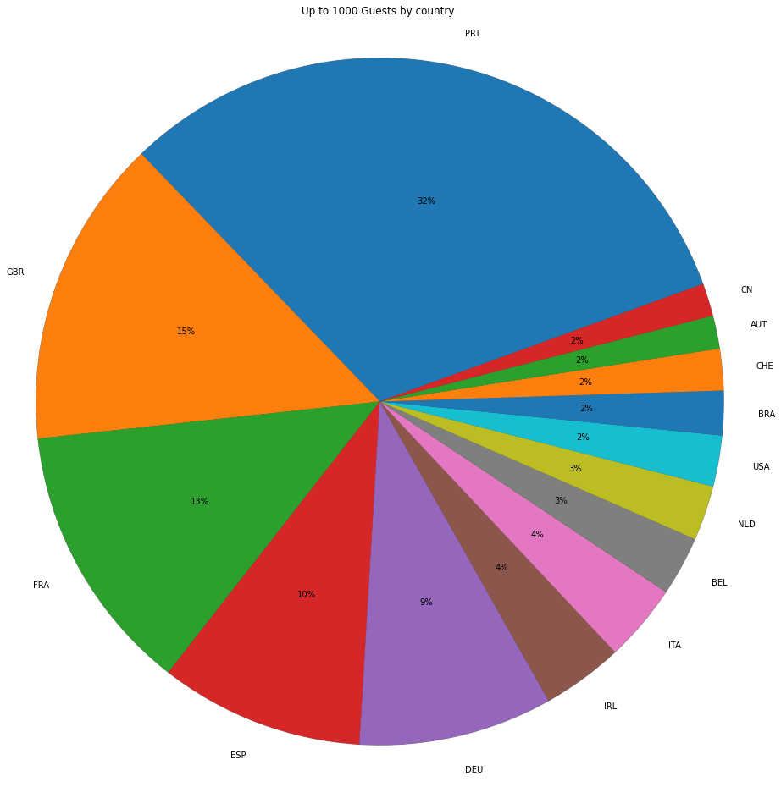
Where do the guests come from?
-Most of the guest are national (32%), follow by Great Britain (15%), France (13%), and Spain (10%

Slide 6
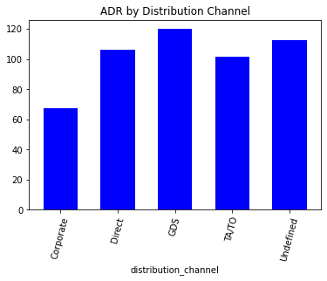
On average, the Daily rate cost is higher when reservations are made using a Global Distribution System (GDS), (€ 119.93) and we have the lower rates for Corporate clients (€ 67.25. Travel Agencies have the second-lowest rate (€ 101.62
How much do guests pay for a room per night?

Slide 7
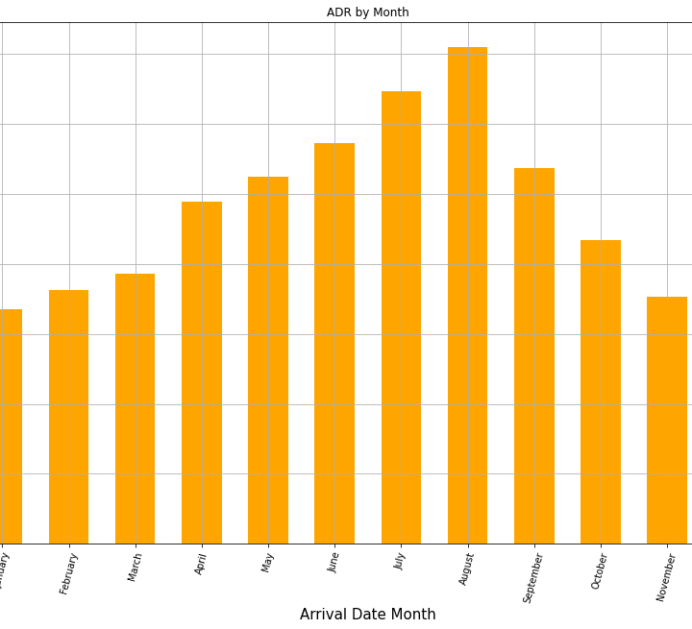
How does the price per night vary over the year? The summer months are the most expensive and the winter months are the most affordable

Slide 8
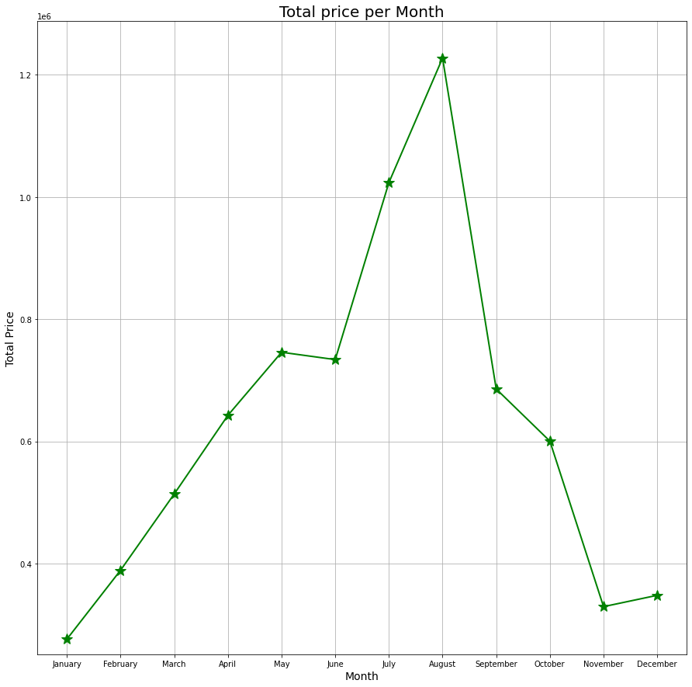
How does the price per night vary over the year? The summer months are the most expensive and the winter months are the most affordable

Slide 9
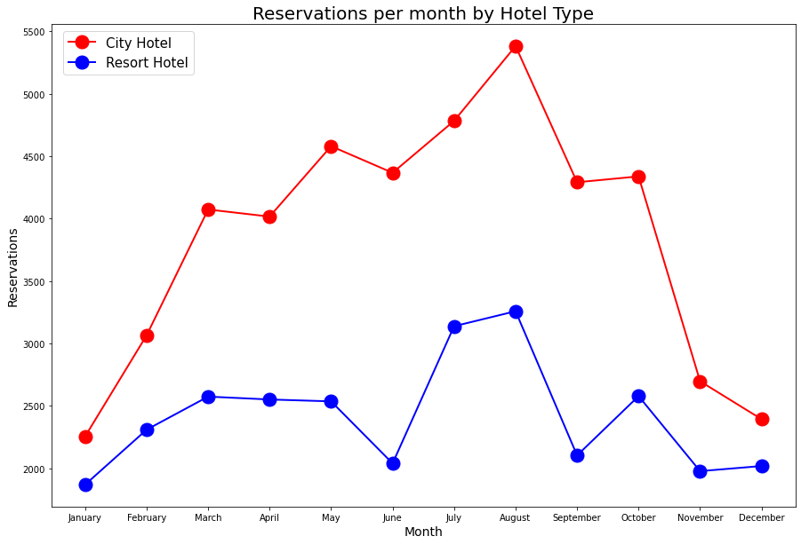
Which are the busiest month?

Slide 10
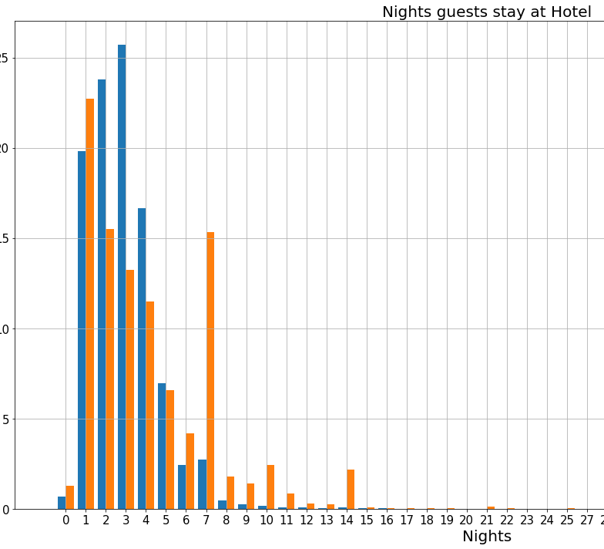
How long do people stay at the hotels?

Slide 11
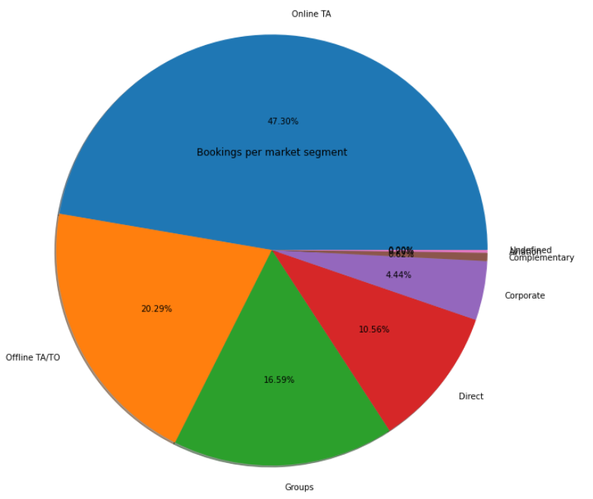
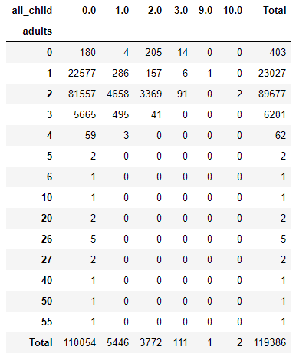
Bookings by market segment 47.30% of bookings were made online, 20.29% offline. The rest were made by groups, corporations, directly at the hotel or by airline packages. From the table, most of the reservations are made by adults without children(110,054 – 92%). Most of the rooms are reserved for two adults than by single adults.

Slide 12
Bookings by market segment
47.30% of bookings were made online, 20.29% offline, by travel agents (TA) or Tour operators (TO)
The rest were made by groups, corporations, directly at the hotel or by airline packages

Slide 13
Bookings by market segment
From this table we can deduce that of the 119,000 reservations, 110,054 were reservations for without children, most of them couples, followed by clients traveling alone.
When there are more bookings with children, two adults travel, we can deduce that they are couples and their children

Slide 14
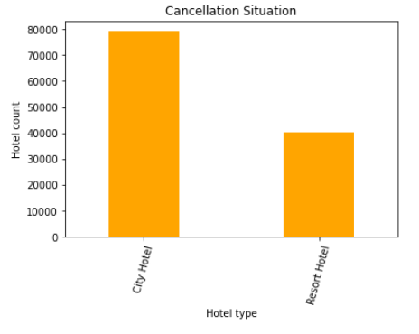
How many bookings were canceled? 37,04% of total bookings were canceled

Slide 15
Cancelations
37,04% of total bookings were canceled

Slide 16
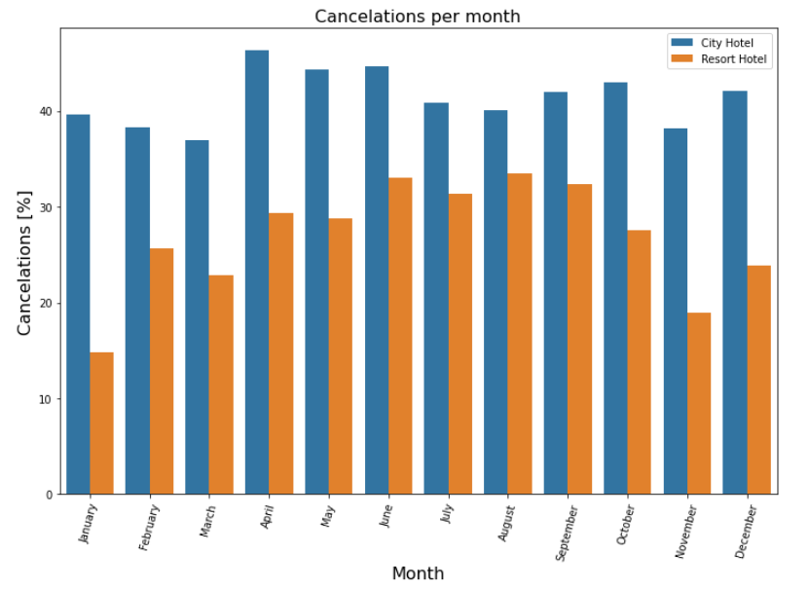
Cancelations per month
August is the month with more cancelations and January is the month with less cancelations
For city hotels there is not much variance between months
For the Resort hotel it is highest cancelations in the summer and lowest during the winter

Slide 17
Which month have the highest number of cancelations? August is the month with more cancelations and January is the month with less cancelations For city hotels there is not much variance between months For the Resort hotel it is highest cancelations in the summer and lowest during the winter

Slide 18



Make a Plan
Set a destination and/or travel theme
1
Set travel dates, mode of travel, and find accommodations
2
Find local attractions, food venues, and activities
3

Slide 19

Any Questions?
Thank you

